Slide 1


Mental Health Leads Network group.
Chair: Liz Nightingale – Green Park School Head
Presenter: Fiona Bowen – Psychology Assistant (EPS)
28th September 2023

Slide 2


Agenda
Introductions
Service Updates – Mental Health Support Team (Paul Davies), Public Health (James Dove),CAMHS (Allie Carr) & Educational Psychology Services
Questions?
Autism & Anxiety presentation – Fiona Bowen (Educational Psychology Assistant)

Slide 3
The mentimeter response from the last MHL has been appreciated and we have used your contributions to choose various topics to discuss over the academic year.
Autism and Anxiety
Autism & Anxiety: FBowen ©

Slide 4
Aims of this presentation
Overview of Autism Spectrum Disorder and Anxiety
Autism and Anxiety in Education (Identifying the areas of difficulty)
Anxiety ‘build up’ and ‘Masking’
Autism and Anxiety in Secondary School
Examples of Autism & Anxiety in school – Case studies
Provide resources, tools, examples and signpost where to find them which will encourage ‘good practice’ and information sharing.
Autism & Anxiety: FBowen ©

Slide 5
Contents
About Autism and Anxiety – Statistics
Autism and Anxiety in School
‘A different view of the world’
Sensory integration issues
Autism and Anxiety – ‘Masking’
Some examples where CYP with autism may experience anxiety at school.
Anxiety over food and eating – ARFID
Case studies – Jake and Mia
Strategic support for Autism and additional needs
Resources
References – Where to find useful resources/information
Autism & Anxiety: FBowen ©

Slide 6
Autism
Autism is a lifelong developmental disability which affects how people communicate and interact with the world. More than one in 100 people are on the autism spectrum and there are around 700,000 autistic adults and children in the UK. (NAS, 2023).
The DSMV Autism diagnosis would involve the individual to demonstrate a DYAD of impairments. The DYAD splits the characteristics of autism into two areas:
Social Interaction / Communication Difficulties and Limited Interests/Activities (repetition), this will include sensory issues.
Autism Spectrum Disorder is still the official diagnostic title, however Autism Spectrum Conditions (ASC) are now used interchangeably with schools and other organisations and include the former diagnosis of Asperger Syndrome.
Please note: An individual can demonstrate autistic traits but not have a diagnosis of autism.
Autism & Anxiety: FBowen ©

Slide 7


DYAD of Impairment (DSMV)
Restricted and repetitive behaviours
Autism
Spectrum
Disorder
Social Communication and Interaction
Autism & Anxiety: FBowen ©

Slide 8
Some signs and Symptoms of Autism Spectrum Disorder (ASD)
Social Communication
Autistic people have difficulties with interpreting both verbal and non-verbal language like gestures or tone of voice.
taking things literally and not understanding abstract concepts
needing extra time to process information or answer questions
repeating what others say to them (this is called echolalia)
Social Interaction
Autistic people often have difficulty 'reading' other people - recognising or understanding others' feelings and intentions - and expressing their own emotions. This can make it very hard to navigate the social world. Autistic people may:
appear to be insensitive
seek out time alone when overloaded by other people
not seek comfort from other people
appear to behave 'strangely' or in a way thought to be socially inappropriate
find it hard to form friendships. (National Autistic Society, 2023).
Autism & Anxiety: FBowen ©

Slide 9





Sensory integration issues and Autism/ADHD
Vision
Hearing
Touch
Smell
Taste
The vestibular system – sense of movement
Proprioception system – positional sense
Interoception is the collection of senses understanding the internal state of the body.
Autism & Anxiety: FBowen ©
Notes:
An example of interoception challenges – A CYP may complain of having a ‘tummy ache’, when in fact they have an ear or throat infection!

Slide 10
‘You must be a genius with maths & computers!’
‘You don’t look autistic’
‘But you have good eye contact’
‘Aren’t we all a little bit autistic?’
‘It’s not a big deal’
Autism & Anxiety: FBowen ©

Slide 11

Anxiety in Education
Anxiety is a typical part of our everyday lives, it is okay to feel worried about starting a new school, getting ready to do an exam or performing at a school play. However persistent feelings of being worried and anxious that disrupt a child or young persons every-day life can be debilitating and stressful.
Autism & Anxiety: FBowen ©

Slide 12
Anxiety and Autism
According to Senior Clinical Psychologist Dr Jaqui Rodgers evidence suggests that when autistic people experience anxiety there may be some aspects of their experience that are different from anxiety as experienced by non-autistics (Kerns et al, 2014). There are 4 key areas that may especially relate to anxiety for autistic people:
Research suggests that up to 85% of autistic individuals will suffer from anxiety. Whilst anxiety is not a part of the diagnostic criteria for autism, individuals with the condition have high levels of anxiety
A significant number of children will suffer from extreme anxiety, this can affect not just the young person but family members too! Often, some children are too anxious to attend school or social events.
An autistic child is twice as likely as a neurotypical (non-autistic) child to experience anxiety.
Difficulty recognising emotions of self and others.
Sensory sensitivities.
Difficulty with uncertainty
Performance anxiety
Autism & Anxiety: FBowen ©

Slide 13

Anxiety and Autism in School
Identifying areas of difficulty in School
School is the place where autistic CYP will experience the most potential change.
School environment is where they will have the least amount of control
Limited or no choice(s) about who, what and when?
The school environment may not be conducive and many autistic CYP who experience sensory difficulties struggle to get through the typical school day
Play time at school can also be a stressor and induce further anxiety.
Autism & Anxiety: FBowen ©
Notes:
It should come as no surprise that autistic children and young people experience anxiety, especially at school. If we think about it, school is the place where they are going to experience the most people, most potential change and least amount control. They have to go, day after day with little choice about who, what and when. School takes up almost half of a child’s waking hours and is set in a physical environment that may not be easy for those with sensory differences.

Slide 14
A ‘different view of the world’
Imagine not knowing what the ‘rules’ are and only ‘knowing’ they exist when you get them wrong? or
Imagine a world which sometimes makes no ‘logical’ sense and where there seems to be no functional reasoning.
Not knowing what the rules are, what is happening?, what will happen next? and why we do something must be confusing to the CYP with autism and anxiety inducing.
Autism & Anxiety: FBowen ©
Notes:
Examples of not knowing the rules: A CYP may not observe that their peers are in a queue waiting to collect worksheets from a teacher and go straight to the teachers desk to get their own copy! Rules or simple instructions may need to be explicit.
Inference is a guess or an opinion formed that you may have after looking at the information available, example: Wilma goes to a restaurant for her birthday meal and a fire breaks out during the dinner, Wilma is upset and cries, when ASD child is asked why might Wilma be upset/crying, the yp says ‘because she doesn’t like fires’!

Slide 15

Anxiety ‘build up’!
Young people on the autism spectrum will demonstrate their anxiety in different ways from ‘shut-downs’ and silence to melt-downs which once started can go on for hours.
Often a culmination of events can trigger anxious behaviour, some of these could be:
Bus/taxi is late for school
Forgot their lunch at home or lunch menu at school has a last-minute change
Different teaching assistant today!
Wet ‘indoor’ play today as its raining during play-time
Autism & Anxiety: FBowen ©

Slide 16
Autism and masking
Q: What is masking?
A: To ‘mask’ or to ‘camouflage’ means to hide or disguise parts of oneself to better fit in with those around you. It is an unconscious strategy all humans develop whilst growing up -to connect with those around us. (NAS, 2022).
Mimicking others to ‘fit in’, this includes non-verbal behaviours
Developing social scripts to get through social situations
Self-soothing, stimming, repetitive behaviours
Q: Why mask?
To avoid the need to be seen as someone different, to ‘fit in’ with others avoiding judgement and prejudice
Masking can help the autistic individual to cope with or repress certain behaviours that others may find unusual or different.
Girls tend to mask as they are more socially inclined to have a ‘need’ to ‘fit in’ with their peers
Autism & Anxiety: FBowen ©
Notes:
Another ‘opportunity’ for anxiety to present itself can be seen with masking

Slide 17

The effects of masking
CYP may find it difficult to ‘keep up’
Identity issues
Autistic burnout -which can be described as chronic exhaustion, loss of skills, and reduced tolerance to stimulus.
https://www.autism.org.uk/advice-and-guidance/professional-practice/autistic-burnout
Dr Dora Raymaker (2022) NAS
Autism and ‘masking’
Autism & Anxiety: FBowen ©

Slide 18
Masking in relation to anxiety and autism!
‘The worse we feel about ourselves the more we mask, and the more we mask the worse we feel. By learning how to change the negative thoughts and feelings we have of ourselves from masking, we may even find the need to mask less.’
Dr Hannah Belcher, (2022), The National Autistic Society
https://www.autism.org.uk/advice-and-guidance/professional-practice/autistic-masking
Autism and ‘masking’
Autism & Anxiety: FBowen ©
Notes:
The best solution to reducing the need for autistic people to mask is to spread awareness to non-autistic people of different neurodiverse behaviours and thinking patterns. When non-autistic people know someone is autistic, they seem to judge them less harshly.
A focus on self-awareness, self-care and protection and improving mental health and wellbeing. This doesn’t mean stopping masking altogether, it just means becoming more aware of how CYP use the strategy to cope, and what effect it has on them.

Slide 19
Some examples where CYP with autism may experience anxiety at school
P.E can be an anxiety inducing area where learners feel that changing their clothing in shared areas or removing clothes altogether is problematic for them.
Eating – Many CYP have difficulties eating at school (some may not eat at all during school hours). This may be for several different reasons such as noise, smells, ‘overcrowded areas’, seating arrangements and other sensory / environmental issues.
Walking into school – Seeing lots of other CYP and possibly parents/carers all congregated around the school entrance can be daunting for some and debilitating for others. Returning to school after a term break can also be difficult for some CYP.
Change – timetable- (some CYP struggle to cope with the demands of a school timetable because they have difficulty organising and prioritising) , lessons, teacher, teaching assistant changes, school trips. This could include transition from one room to another, seating plan changes, changes to the classroom area or change of original set plan.
Autism & Anxiety: FBowen ©

Slide 20

Anxiety over food and eating
Some learners with Autism have anxiety over food and eating, this can worsen in school.
ARFID – Avoidant Food Restrictive Intake Disorder. Someone with ARFID avoids eating certain foods, limits/restricts how much they eat, or does both. ARFID is diagnosed by medical professionals and is on the DSMV (2015).
Not eating at snack time or avoiding lunch/lunch area.
Feeling tired and lethargic.
Worrying about eating or being around others who are eating/what is being eaten (by others).
Fear of choking or being sick
Autism & Anxiety: FBowen ©

Slide 21
Anxiety over food and eating
ARFID is more common in children with learning difficulties, attention deficit hyperactivity disorder (ADHD) and autism spectrum conditions (ASC).
Individuals with sensory difficulties and/or Autism Spectrum Conditions (ASC) can often avoid certain foods due to certain smells, tastes or textures, which can lead them to avoid specific types of foods altogether.
Attention-deficit hyperactivity disorder (ADHD): Stimulant medications for ADHD can cause reduced appetite (and in some cases) can cause symptoms of ARFID to worsen.
For further Information about ARFID go to: https://www.arfidawarenessuk.org/about
Autism & Anxiety: FBowen ©

Slide 22
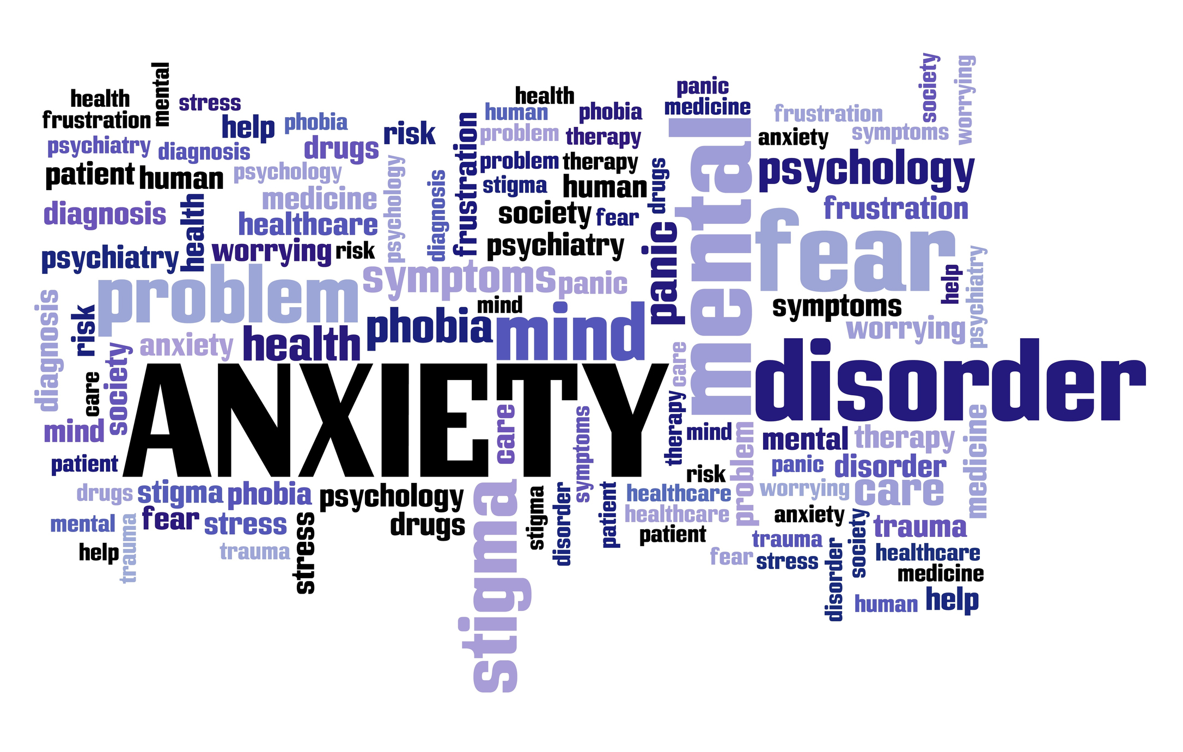
Autism and Anxiety in Secondary School
Autism & Anxiety: FBowen ©

Slide 23
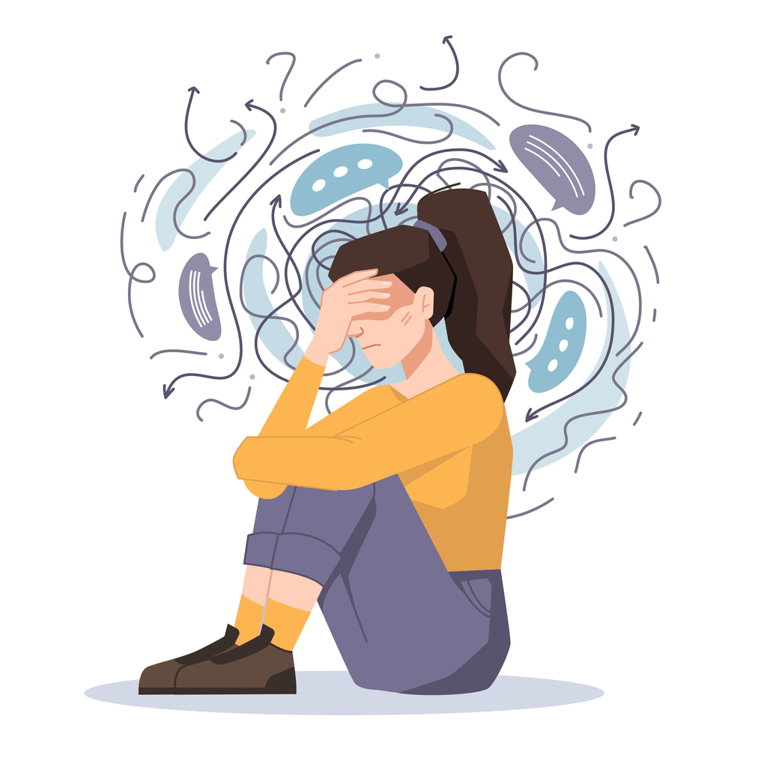

Anxiety and Autism in Secondary School
Transition from Primary to Secondary School can be an especially anxious time for CYP with autism. Secondary Schools have more pupils, different subject teachers, larger eating areas and different expectations (perhaps less nurturing). CYP with autism may experience new or different sensory challenges and find it difficult to navigate and self-regulate emotionally.
Support plans and transition support from everyone involved with the young person is important. MKCC Local Offer have resources and information about ’ALL’ ‘Transition’s. available here:
https://www.mksendlocaloffer.co.uk/education-and-send/starting-or-changing-school-and-transition-support
Autism & Anxiety: FBowen ©

Slide 24
Communication challenges
Difficulties with spoken language such as tone of voice and non-verbal body language. Not understanding banter, jokes or sarcasm can often make CYP with autism feel anxious and confused
Social challenges
Understanding social situations and the complexity that is often involved can cause CYP to respond inappropriately or rudely especially if they have misunderstood or misinterpreted a situation. This promotes more anxiety if they are made fun of by their peers.
Bullying and Intolerance
Unfortunately, the differences between CYP with autism and their peers can lead to some level of bullying.
Sensory Issues
Large crowds in high school, bright lights, loud noises, changing classrooms, getting the school bus. CYP who seemed to ‘cope well’ in smaller primary school settings often struggle with larger Secondary settings.
Autism & Anxiety: FBowen ©
Notes:
Key areas which may affect CYP with Autism at Secondary School.

Slide 25
Strategic support for Autism and additional needs
Overview
Adapt use of language and communication
Aim to be as consistent as possible
Visual aids and modelling
Use transition supports such as sand timers, visual timetables, first and next boards (pictures, symbols and objects)
Understand and consider the function(s) of behaviour
Develop emotional regulation skills
Consider the impact of the environment/sensory stimuli
Autism & Anxiety: FBowen ©

Slide 26
Case Study – Jake year 7
Jake has an ASD diagnosis; he is known for having a quick temper and often displays anxious behaviour when there are any changes to his routine. This morning he has walked into his first session late.
The teacher tells him to ‘quickly’ sit down and get his workbook and equipment out ready to start the lesson, she starts to tell him what he has missed so far. Jake proceeds to move slowly and swipes a couple of pens already at his workspace onto the floor, he sits down but does not appear to be ready to start the session in fact he seems angry. Another pupil makes a remark at him and he ‘swears’ at them and declares he is not doing the work now because it’s boring!
Autism & Anxiety: FBowen ©

Slide 27
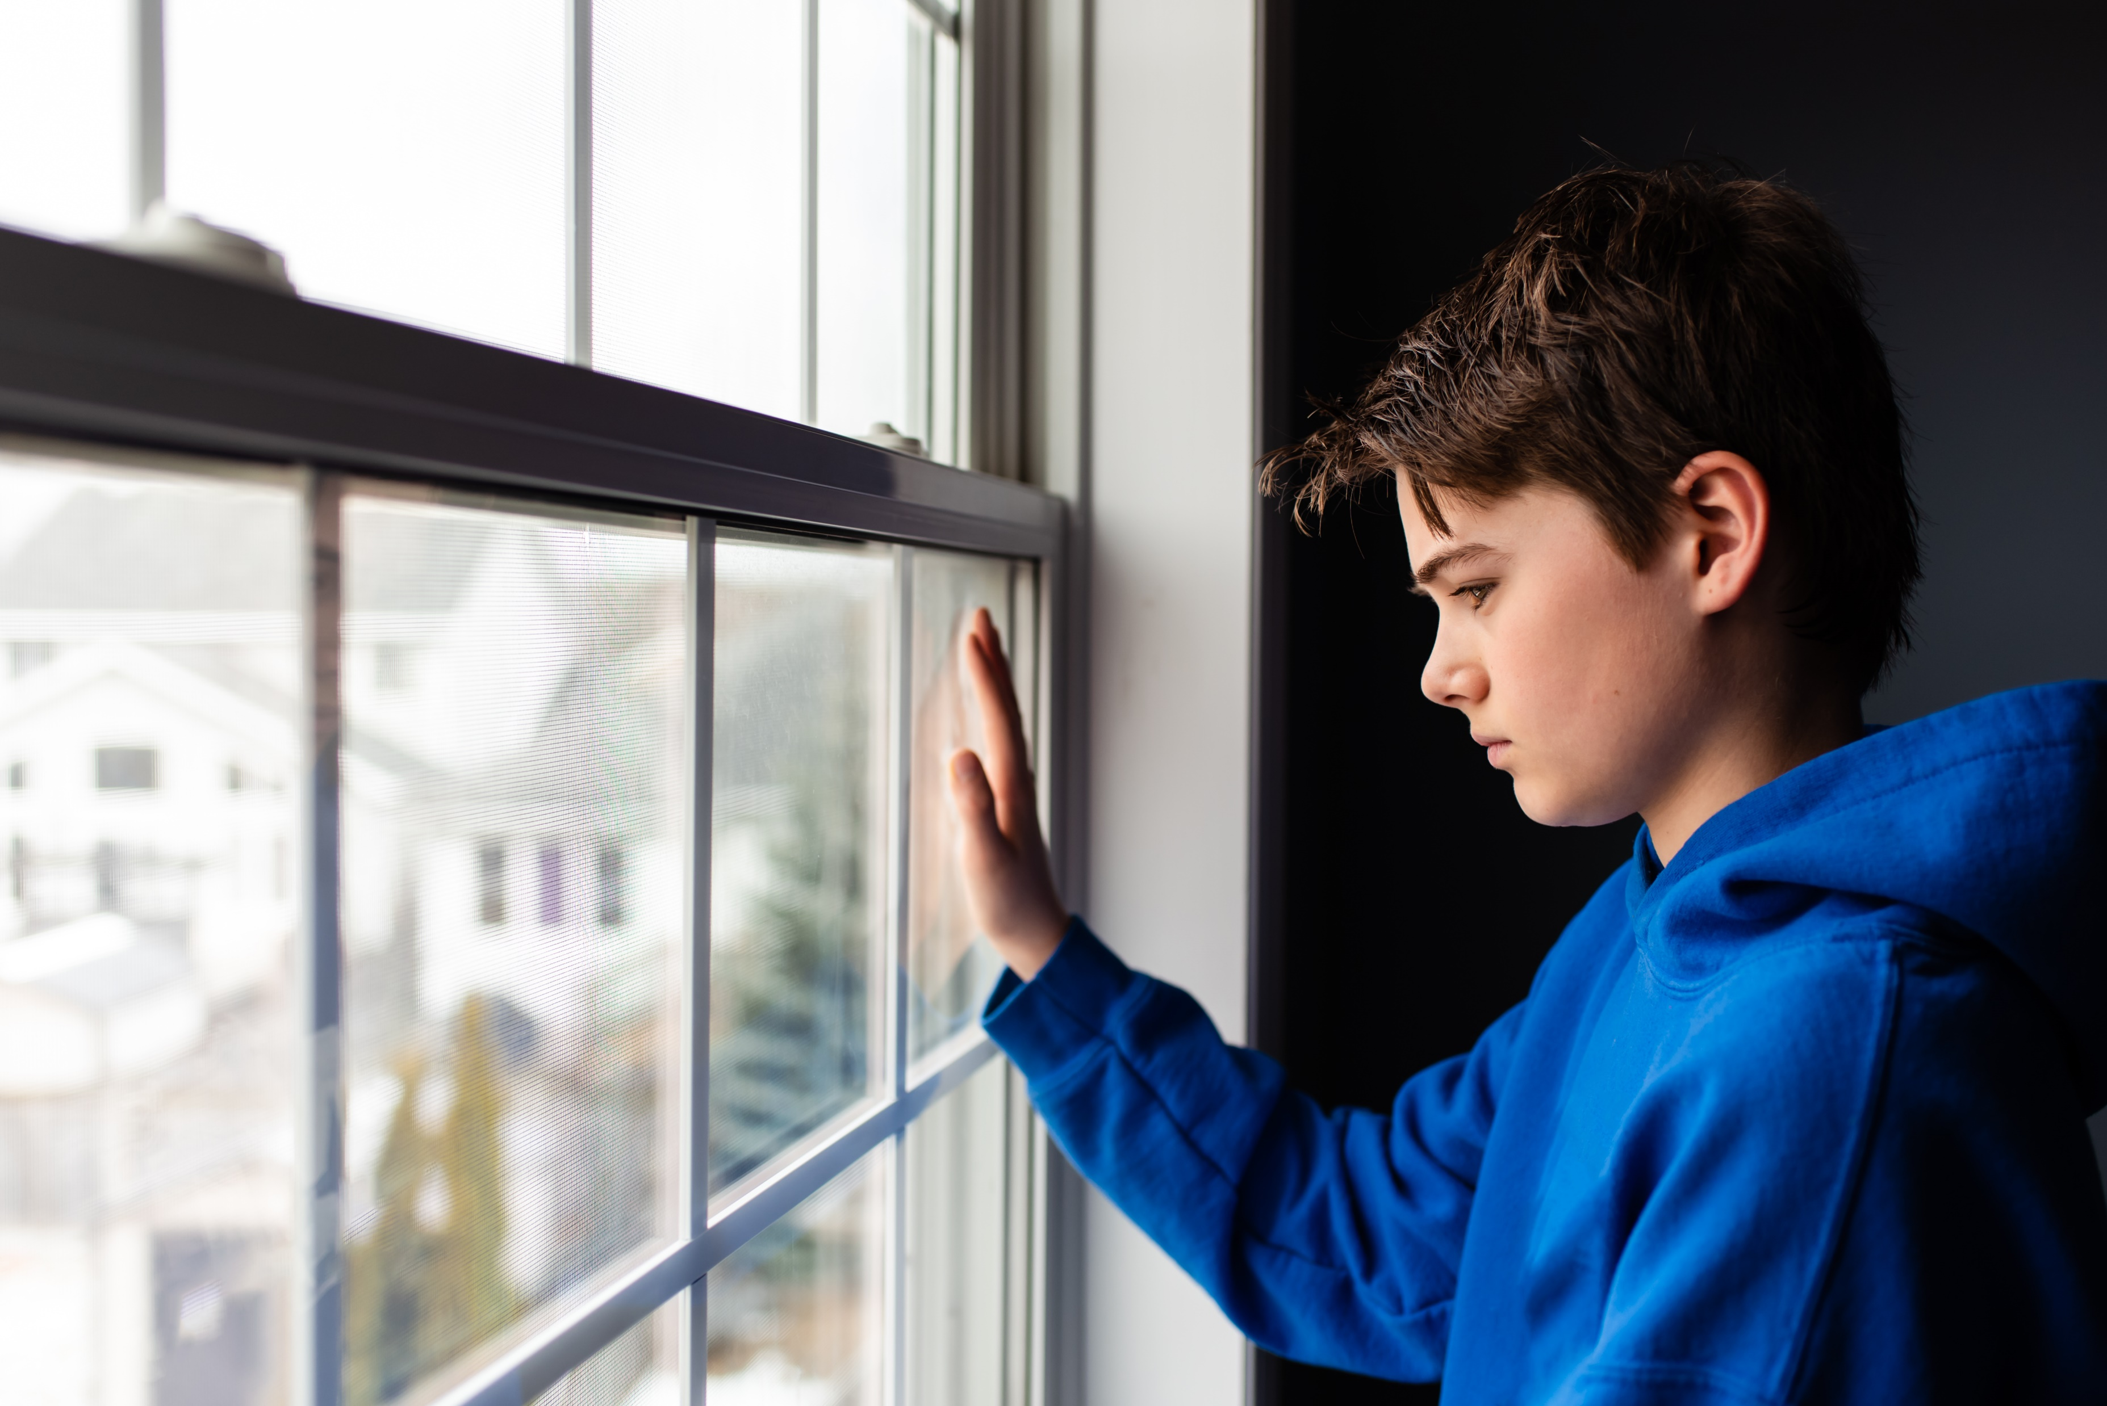
Case study – Jake year 7
Q: What factors could be affecting Jake?
Q: What can be done at this stage?
Q: What can be done to support Jake ‘going forward’?
Autism & Anxiety: FBowen ©

Slide 28
Jake - year 7
Q: What factors could be affecting Jake?
A: Probable factor is that he is late starting the morning session, he is out of routine/sync. However, there could be a combination of factors that are affecting Jake, we don’t know the particulars at this stage and he could be upset about something ‘seemingly’ unrelated.
Q: What can be done at this stage to support Jake but not delay the lesson?
A: It is difficult to support an autistic CYP who is already displaying anxious behaviour as once started it can be difficult for them to ‘change course’, however, possibly offering Jake opportunities to regulate himself (using resources, asking a LSA/TA to support this) and allow for processing time before he starts the session. The person who knows Jake best would be the best to support this.
Q: What can be done to support Jake – ‘going forward’?
A: Asking Jake what would be helpful to him in situations where he is anxious or out of sync/routine, listening to Jakes views is integral to understanding the best ways to support him. Perhaps think about ways in which Jake can ‘self-regulate’, devising a plan to use in situations such as this (e.g. one of the resources suggested), offering a quiet area to work in, visual supports/aids or a snack. Clear instructions, concise language – not using ‘quickly, hurry, come on’! Offering praise when he has been able to self-regulate successfully.
Autism & Anxiety: FBowen ©

Slide 29
Case Study: Mia - year 6
Mia is currently being assessed for possible ASD, she is a quiet pupil who is capable of working academically without much support. However, Mia is often alone at break times, does not want to ‘join in’ activities and often has days off school due to ‘nervousness and sickness’. Mia’s mother states that she is a different child at home compared to school, showing signs of anxiety in the mornings before school, shaking, crying and feigning sickness to avoid school.
Mia says that she has ‘friends’ and that she likes schoolwork but not school! She states that she is worrying about her SATs and that if she does not do well this will be a ‘bad thing’.
Teachers have observed that Mia will say that she is sick or feels unwell on days where they have P.E or assemblies, group activities, despite ‘appearing well’.
Autism & Anxiety: FBowen ©

Slide 30

Case study: Mia - year 6
Q: What assumptions could be made about Mia?
Q: Should anxiety be considered as an issue for Mia?
Q: What possible support would you suggest for Mia?
Autism & Anxiety: FBowen ©

Slide 31
Q: What assumptions could be made about Mia?
Her current assessment for ASD means that ALL of her behaviours may be attributed to autism which can be unhelpful. Also that because she is doing well academically and has no ‘real issue’ in class - that she will be okay and ‘some children in year 6 become anxious about their SATs anyway!’
Q: Should anxiety be considered as an issue for Mia?
Yes, Mia may be ‘masking’ at school and repressing behaviour until she is back home. Social situations appear to be more anxiety inducing for Mia, this type of anxiety could develop into Emotionally Based School Avoidance (EBSA).
Q: What possible support would you suggest for Mia?
Gaining Mia’s views about school and identifying areas where further support is needed such as P.E and assemblies, seeking support from MHST or Educational Psychology consultation. – Plan – Do – Review! Home to School diary?
Autism & Anxiety: FBowen ©

Slide 32

In our previous MHL network meeting (2022), we talked about Positive Psychology and Wellbeing – Martin Seligman’s work (2012). Here is a reminder to take another look at this concept and think about applying this with CYP who have Autism and Anxiety.
Positive psychology's main aim is to encourage people to discover and nurture their character strengths, rather than channelling their efforts into correcting shortcomings.
The PERMA Model is a useful framework for understanding and measuring psychological wellness.
Positive Psychology
Positive Emotion
Accomplishment or Achievement
Engagement
Relationships
Meaning
Autism & Anxiety: FBowen ©

Slide 33
Ways to support – Useful Resources
Energy Accounting -
Positive Psychology
Self-Soothe Box –b
Grounding Technique
Hand breathing/box breathing
Further breathing techniques
Lets talk about anxiety (Anna Freud video)
Support List – who can help me?
Parent/Teacher guidance on Anxiety
MKCC Local Offer (Including link to Transitions)
MKCC SEND Centralised Training offer – List of Autism, Anxiety training
Anxiety worksheet
LEANS – Neurodiversity link
National Autistic Society Website
Autism & Anxiety: FBowen ©

Slide 34
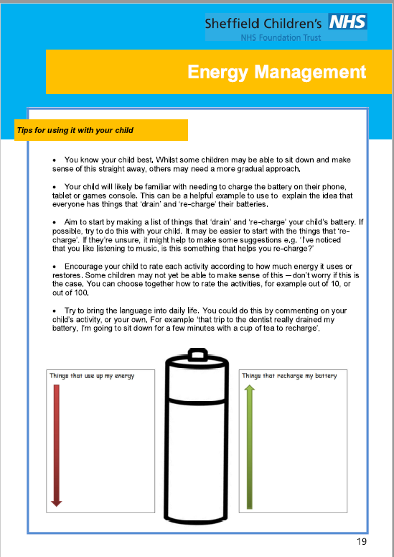
https://www.sheffieldchildrens.nhs.uk/download/846/autism-resources/14638/energy-management.pdf
Notes:
Energy Accounting is a tool created by Maja Toudal and Dr Tony Attwood to manage the day-to-day stress experienced by a person with autism.

Slide 35
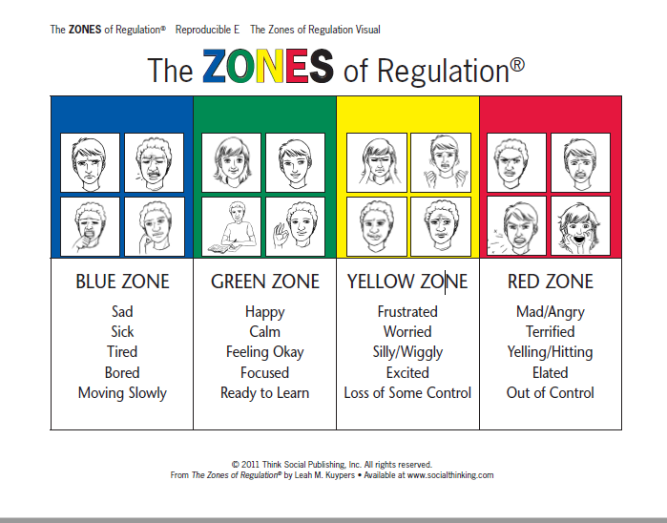
The Zones of Regulation
Notes:
The Zones of Regulation is an approach to support the development of self-regulation in CYP. The Zones provide an alternative ‘visual’ way to think and talk about ‘how we feel on the inside’ – Emotions are sorted into 4 coloured zones.

Slide 36
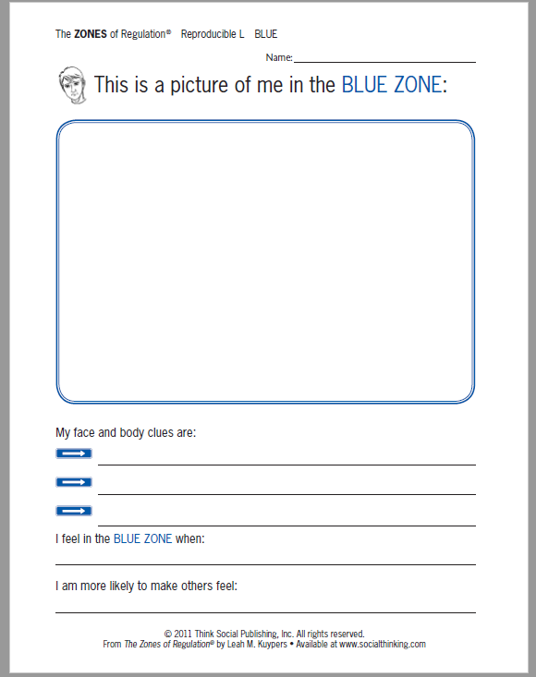
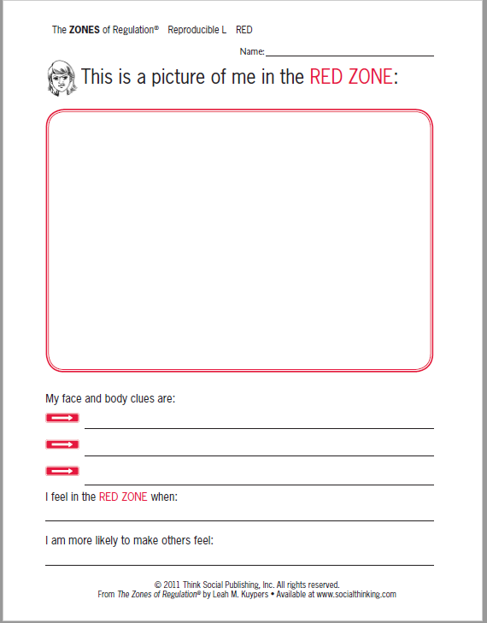
The Zones of Regulation
Notes:
Examples of some worksheets from the Zones of Regulation – Here the CYP can develop their own understanding of how they feel inside and can use this exercise to communicate that to others. Like I said, this is a brief explanation of the zones, Nikki’s email address and resources will be sent out with the post-meeting resources to the network group.

Slide 37
Resources: Try a ‘self-soothe box’
A self-soothe box or sensory box can be useful for helping learners to feel ‘grounded’ and relaxed when experiencing anxiety, dysregulation or low mood.
Consider the following: Touch, smell, taste, music, memories, photos, positive affirmation cards, calming technique cards (box breathing).
A box may include some of the following:
Fidget spinners, squishies, slinkies, cubes, word search, colouring in, collaging, knitting, fabric/material, music (easy access to ear phones, calming playlist), playdough (add a couple of drops of essential oil such as lavender or peppermint to playdough). Bubble wrap/poppers and puzzles.
For more ideas: www.youngminds.org.uk

Slide 38
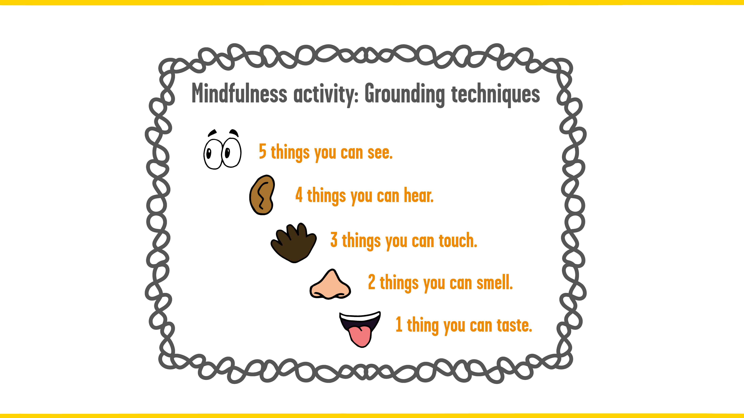
About this resource:
If the young person you are working with is starting to feel overwhelmed, share these grounding techniques with them to help calm them down.
www.youngminds.org.uk
Resource: Grounding technique

Slide 39
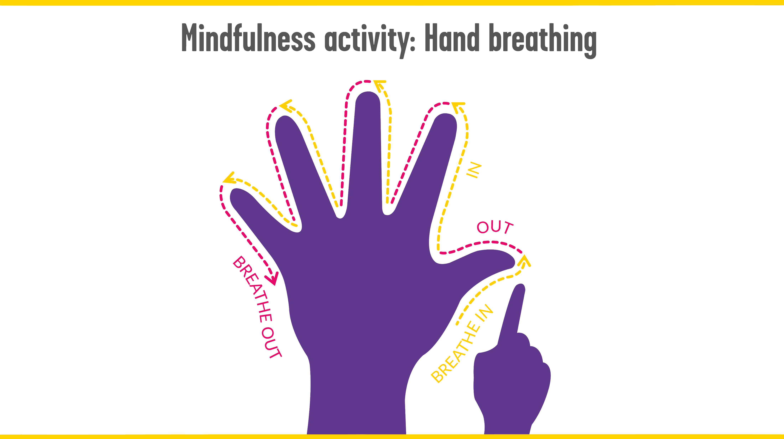
About this resource:
If a young person you are working with begins to feel their breath getting quicker and out of control, use this activity to help them slow down their breathing and calm down.
www.youngminds.org.uk

Slide 40

Further breathing techniques
Breathing techniques and their benefits have been explored for many years.
Scientific studies have shown the benefits of breathing to support health. The NHS have a website link which aims to support Mental Health via the technique of breathing exercises.
https://www.nhs.uk/mental-health/self-help/guides-tools-and-activities/breathing-exercises-for-stress/
Practical interactive resources for managing/coping with anxiety:
https://www.nhs.uk/every-mind-matters/mental-health-issues/anxiety/

Slide 41
https://www.annafreud.org/
Notes:
https://www.annafreud.org/

Slide 42
Anna Freud Resources: https://www.annafreud.org/

Slide 43
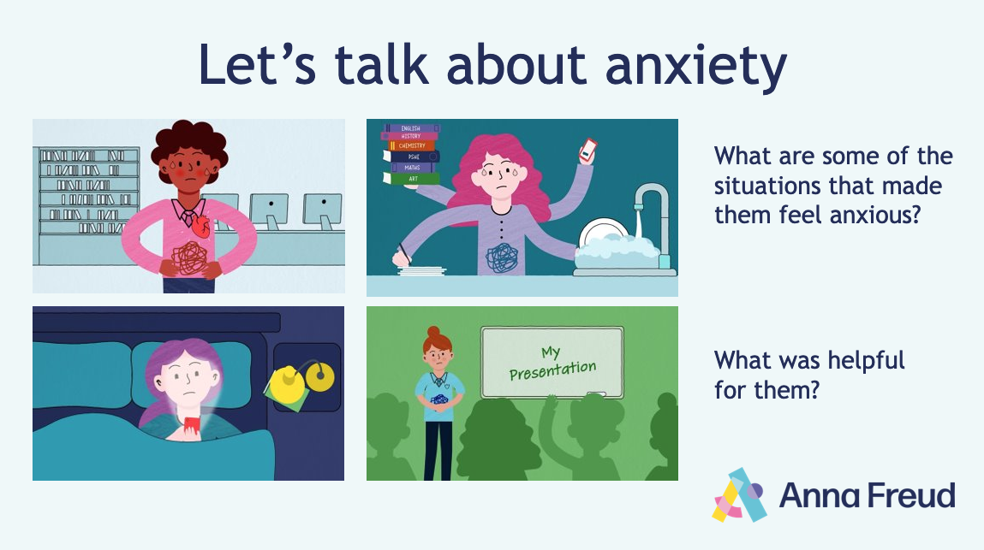

Notes:
Animation link: https://www.youtube.com/watch?v=dknTQktH5Z0
Alternative link: https://vimeo.com/825490584/15cc14f9bc
Introduce the Let’s talk about anxiety animation.
Ask students to look out for the characters on the slide, and to think about the following as they watch:
What are some of the situations that made them feel anxious?
How did it affect them?
What things were helpful for them?
After you have watched the animation, ask for hands up, and gather students’ responses to the questions, referring to the characters on the slides.
Encourage them to make comparisons between the different characters, situations and ways of responding.
Ask students to suggest their own examples of how someone might cope with anxious feelings.
At the end of the discussion, ask students to take a moment to reflect on when they might use any of the strategies covered in the animation.

Slide 44

Further support
Here’s where you can find further support if you need it:
Speak to your teacher
-
-
-
-
Notes:
This slide is editable. Fill this slide with information about where students can find further support in your setting.
Close the assembly by emphasising that anxiety is a normal emotion, and that it’s important to try and find out what works for you.
Remind students that if they’re worried, they should speak to a trusted adult, and possibly seek specialist help (e.g., speak to your GP).
Remind students about the support available at school. Make yourself available to any students who want to speak further.

Slide 45

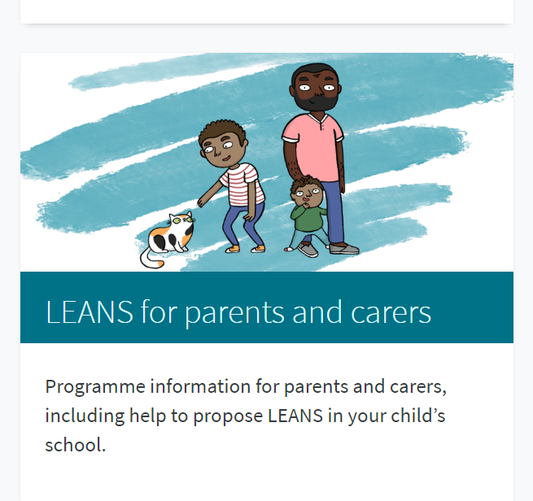

Learning About Neurodiversity at School (LEANS)
A free programme for mainstream primary schools to introduce pupils aged 8-11 years to the concept of neurodiversity, and how it impacts our experiences at school.
Learning About Neurodiversity at School (LEANS) | Salvesen Mindroom Research Centre (ed.ac.uk)

Slide 46
SEND Training and MKCC Support
Understanding and effectively supporting ASC in Primary Schools 27/11/23 – 3.30-4.30pm
Understanding and effectively supporting ASC in Secondary Schools 29/11/23 and 4/12/23
Need to attend both sessions for Secondary.
Early Years Settings (EYS) – Information available in SEND Centralised Booklet on the Local Offer.
Autism in girls – Information available in SEND Centralised Booklet on the Local Offer.
Emotional Regulation using ‘zones’ – Face-to-face (Civic Office) Primary 9/10/23 – 3.30-5.00pm
Emotional Regulation using ‘zones’ – Face-to-face (Civic Office) Secondary 6/11/23 – 3.30-5.00pm
To enrol on a course please see details on the SEND Centralised Booklet on the Local Offer.
If you have any queries, please email: SENDtraining@milton-keynes.gov.uk
Autism & Anxiety: FBowen ©
Notes:
SEND Support line for any queries: 01908 657 825

Slide 47
Thank You

