Slide 1
SEND Strategy 2025 - 2028
Sharing our early thoughts for your feedback
March 2025

Slide 2
Our SEND Strategy
A strategy helps all professionals to work together and towards the same things. In Milton Keynes we have a strategy for special educational needs and disabilities which needs to be refreshed.
We want to hear your views on our suggested new vision!

Slide 3
How have we come up with the vision?
We’ve used:
Feedback from parents and carers, young people and schools
Our ‘self-evaluation’ which looks at whether we are making a difference to children with special educational needs and disabilities and where we might need to improve
Some information about who will likely be living in Milton Keynes in the future, which is known as “population forecasting”.

Slide 4
Our proposed strategy headlines:
Children and young people with SEND
Are Known
Belong
Thrive
in Milton Keynes

Slide 5
Do you think that this is easy to understand?

Slide 6
Do you think it's ambitious?
If everyone worked towards this, would it give you the chance to have the life that you want in the future?

Slide 7
What do you think it feels like to belong?

Slide 8
What would your life be like if you were "thriving"?

Slide 9
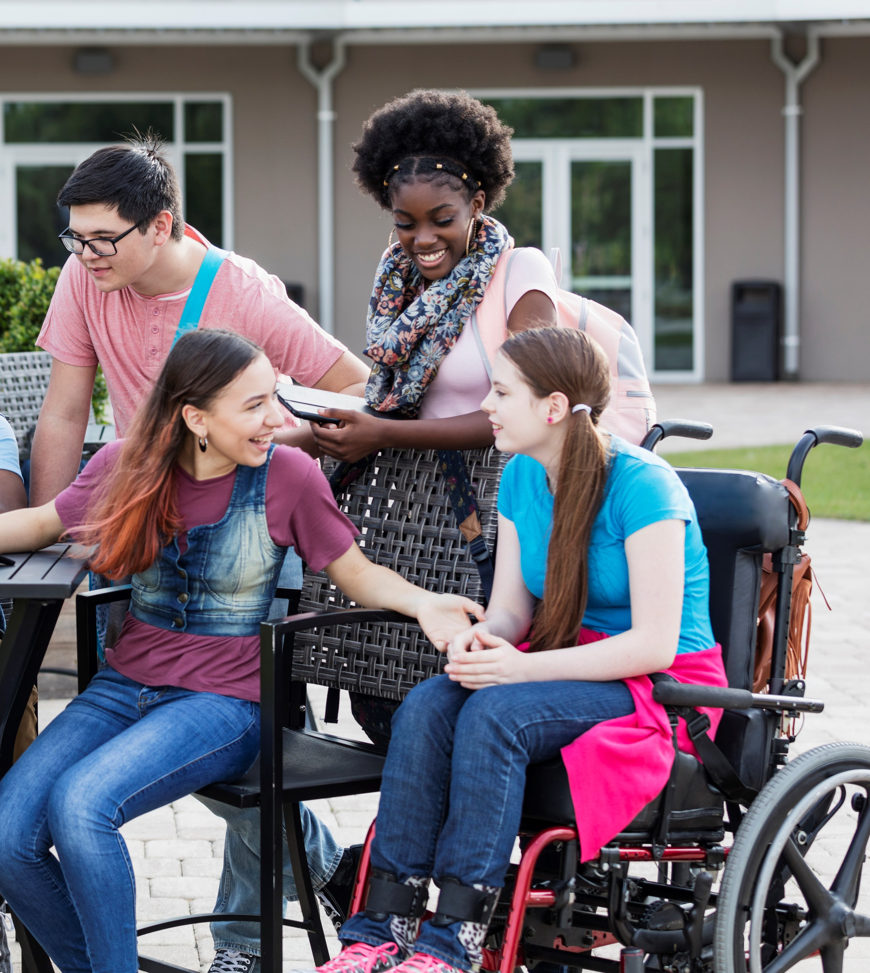
What do you think it feels like when you're "known" by professionals like teachers, health professionals and social workers?

Slide 10
What happens next?
We’re getting views from lots of people – and there’s an online questionnaire if you’d like to tell us more of your thoughts.
In the summer, we’ll publish a more detailed strategy.

Slide 11
If you have any further questions or feedback, you can contact sendpartnership@milton-keynes.gov.uk

